Slide 1
Physics Violation Prediction in Rocket Propulsion Systems
Prepared By :- Sanchan Sandeep Trivedi Guided By :- Hitesh Pande Sir
-using Machine Learning
End-to-End ML Pipeline with Streamlit Deployment

Slide 2
Problem Statement
Rocket engines operate under extreme conditions
Small parameter deviations can cause physics violations
Manual detection is inefficient and error-prone
Objective: Predict physics violation flag (0/1) using propulsion parameters

Slide 3

Dataset Overview

Slide 4
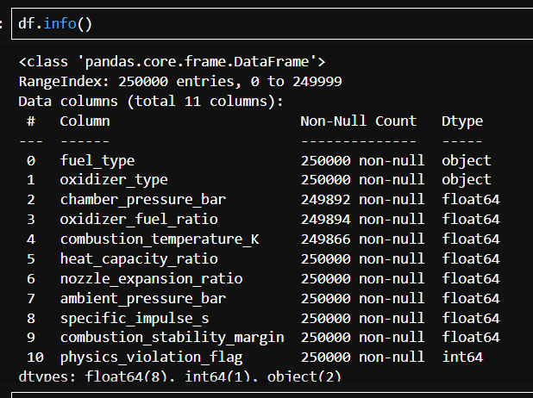
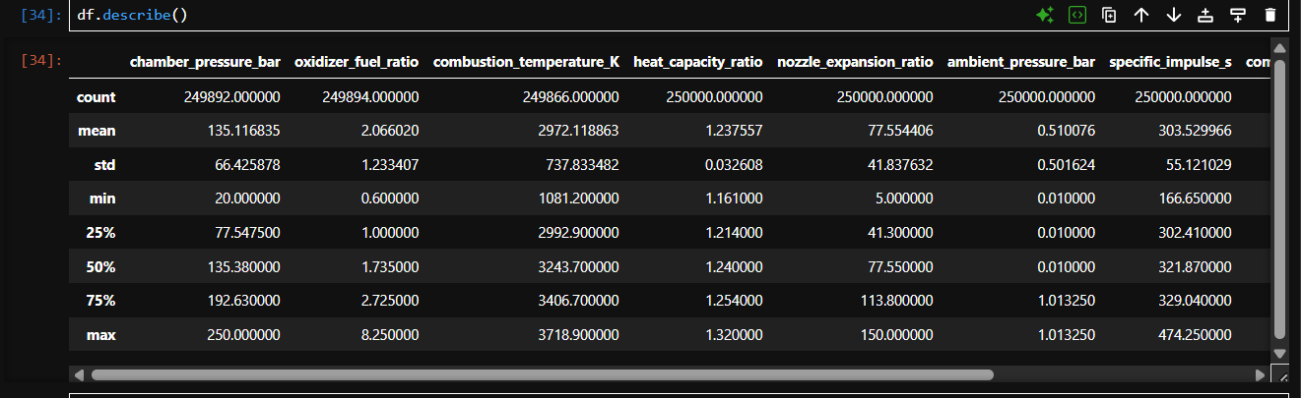

Slide 5
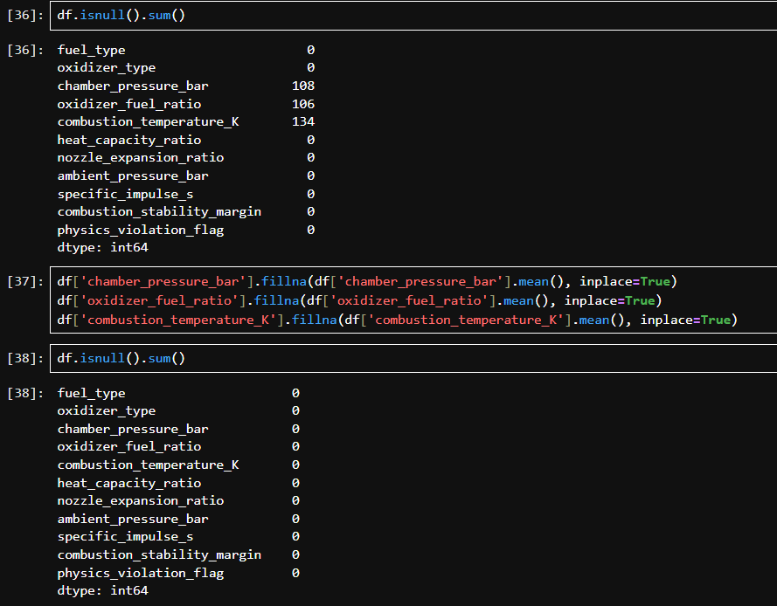

Slide 6

Exploratory Data Analysis (EDA)
Key Insights:
Target variable is class-imbalanced
Combustion parameters show non-linear behavior
Multiple features contain extreme values (outliers)

Slide 7
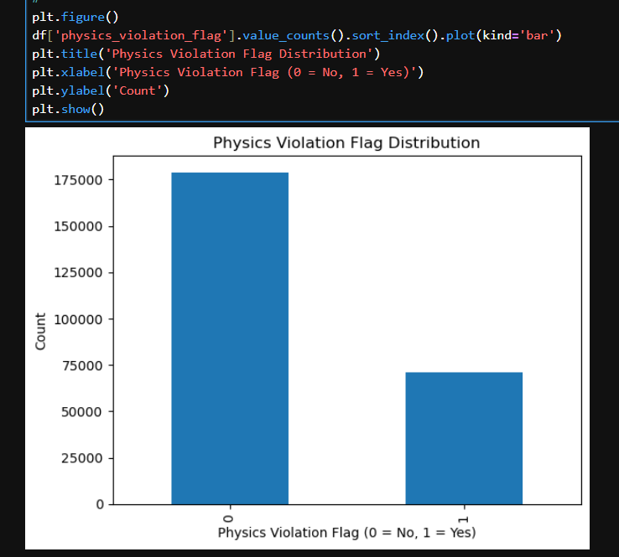
Target Variable Distribution

Slide 8
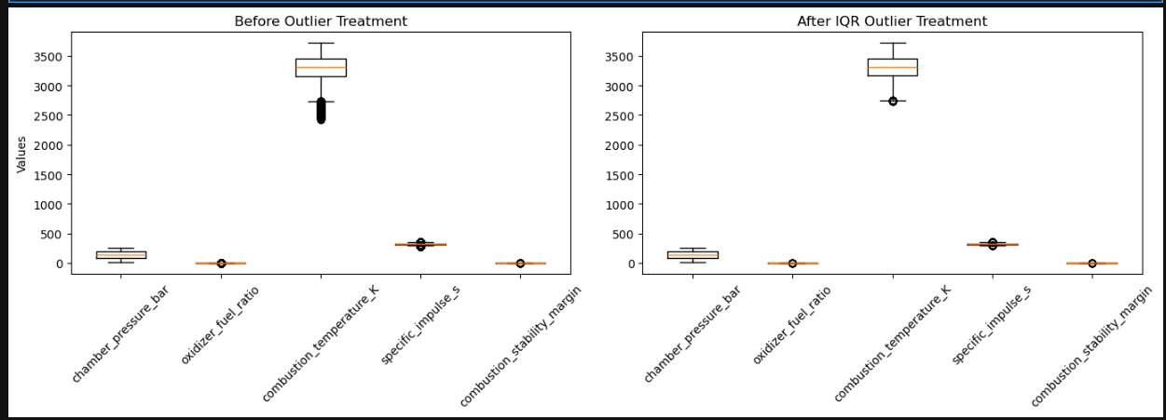
Boxplot of Key Numerical Features

Slide 9
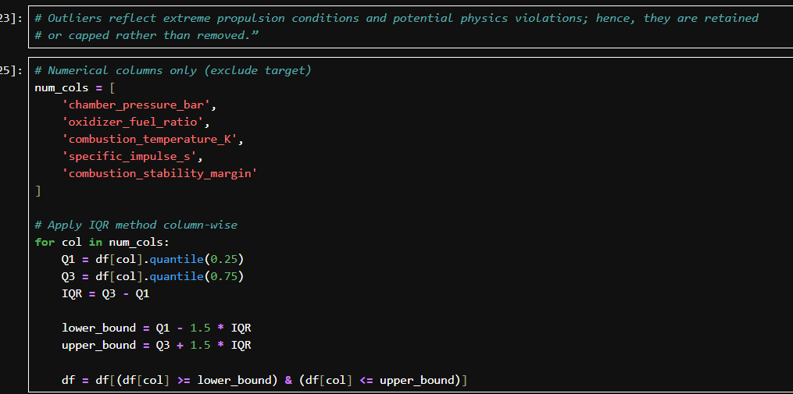
Outlier Treatment With IQR

Slide 10
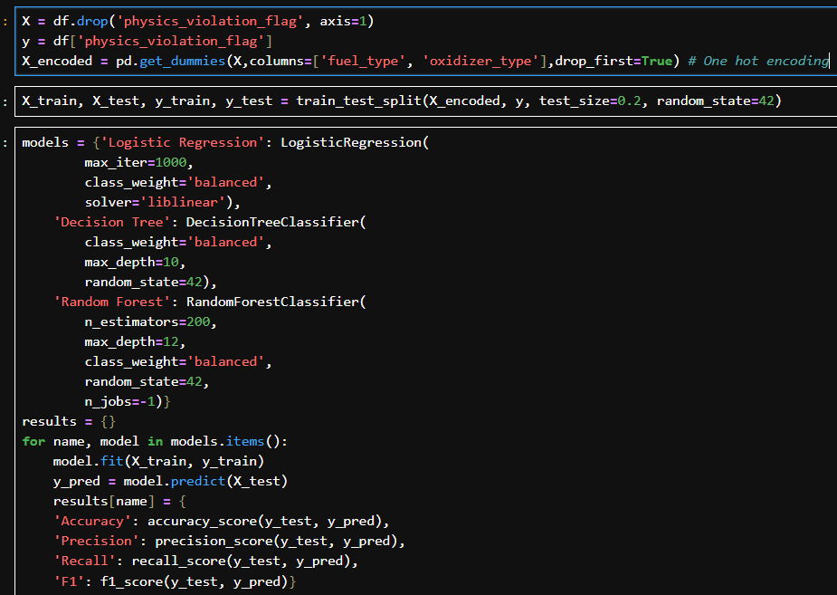
Train-test split

Slide 11
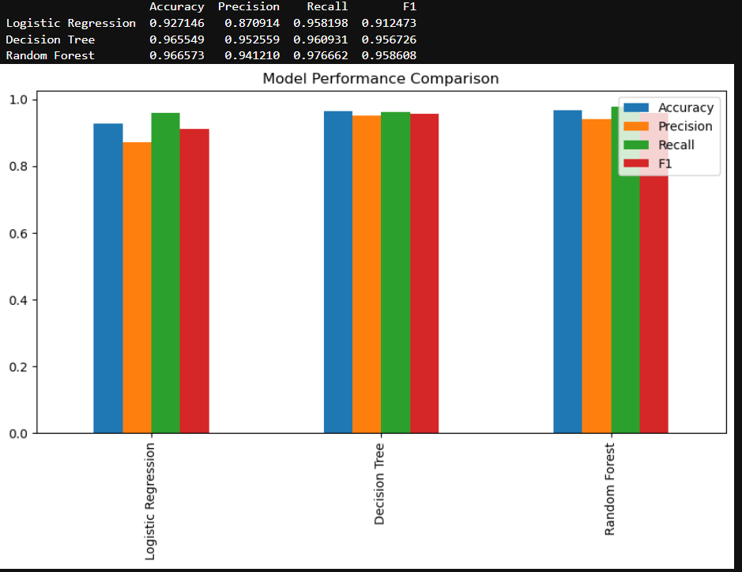
Model Comparison
FINAL VERDICT
Random Forest Classifier is selected as the final model because it achieves the highest recall, minimizing missed physics violations, while maintaining strong overall performance.

Slide 12
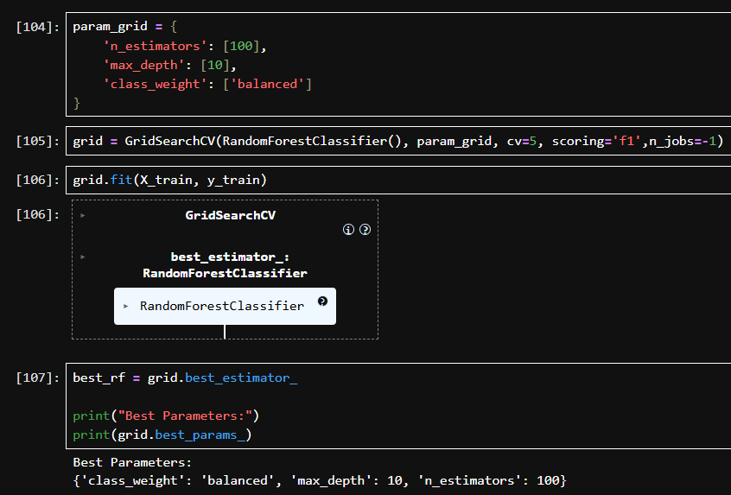
Hyper-Parameter Tuning

Slide 13
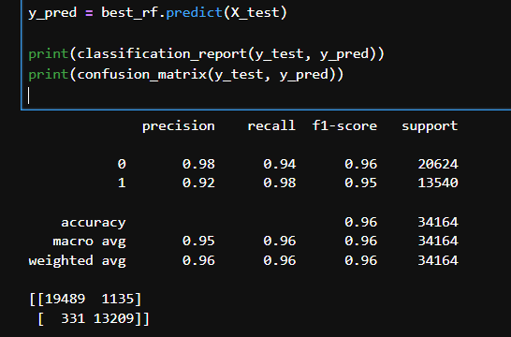
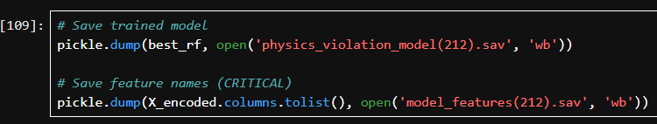
Final Prediction & Model Deployment
Final Prediction & Classification Report , Confusion Matrix
Model Serialization

Slide 14
Product overview
Unique
First to market
Tested
Authentic
Only product specifically dedicated to this niche market
First beautifully designed product that's both stylish and functional
Conducted testing with college students in the area
Designed with the help and input of experts in the field

Slide 15

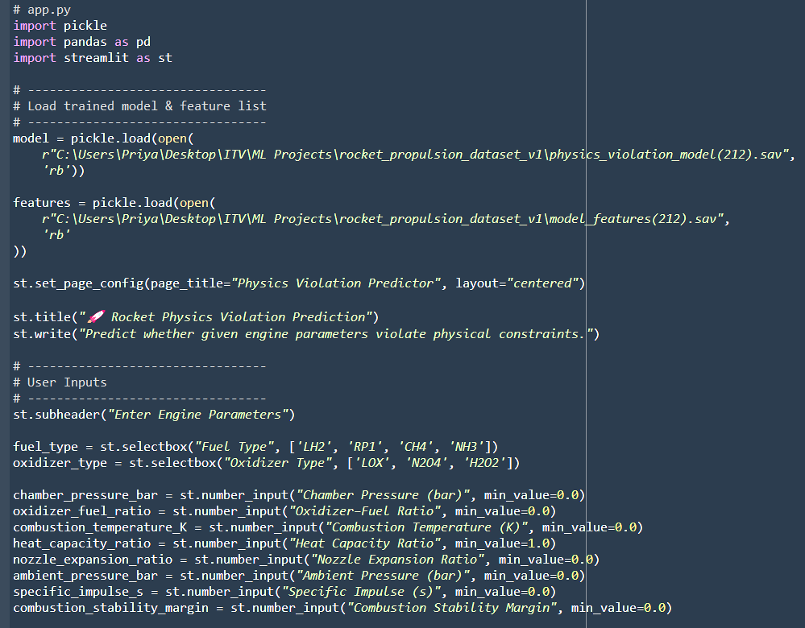
Streamlit Deployment

Slide 16
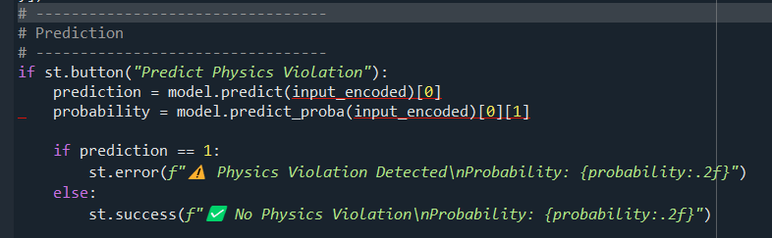
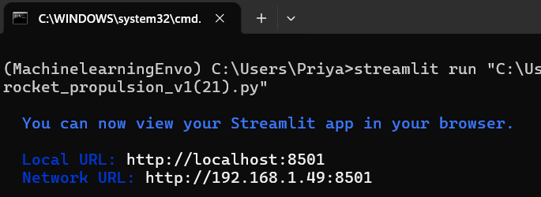
Run App Over Terminal
Final Prediction Button

Slide 17
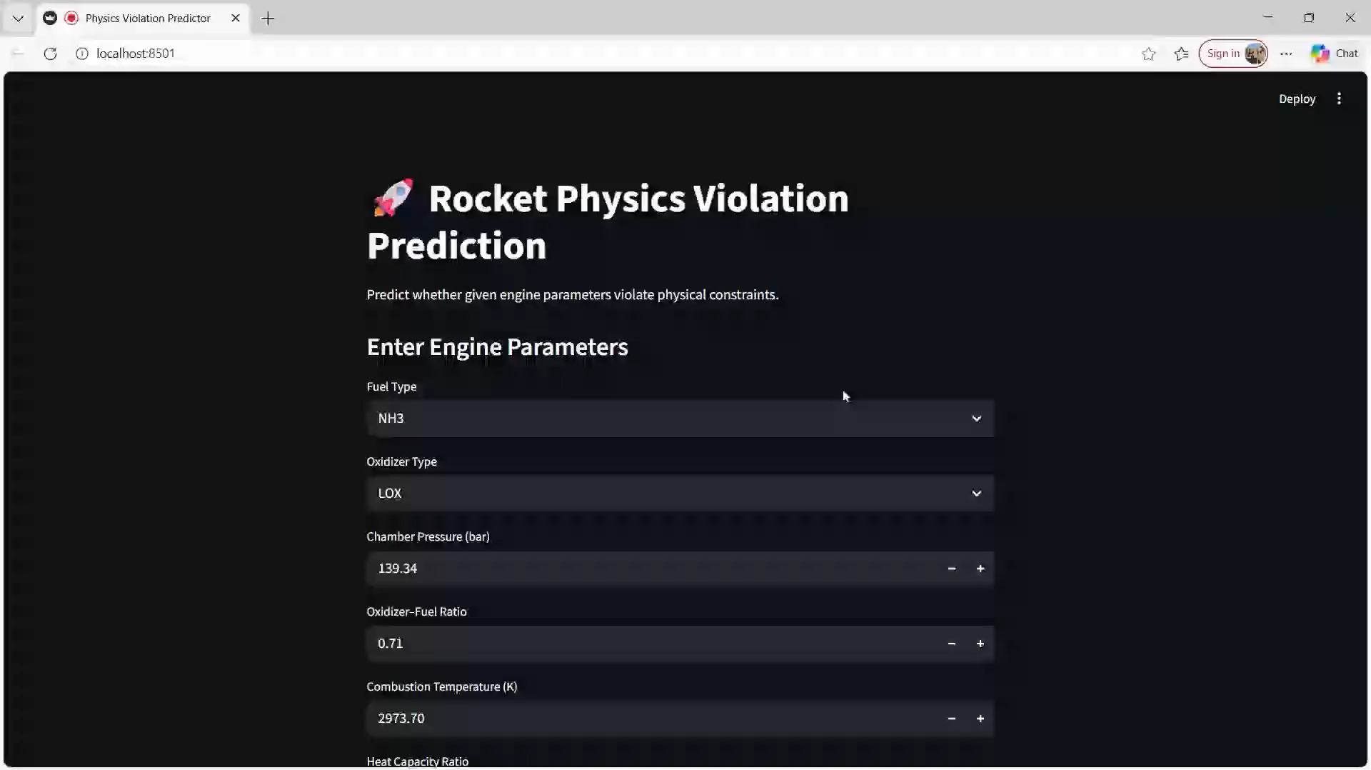

Slide 18
Thank you
Sanchan Trivedi
8080938331
sanchantrivedit@gmail.com
www.firstupconsultants.com

